Slide 1
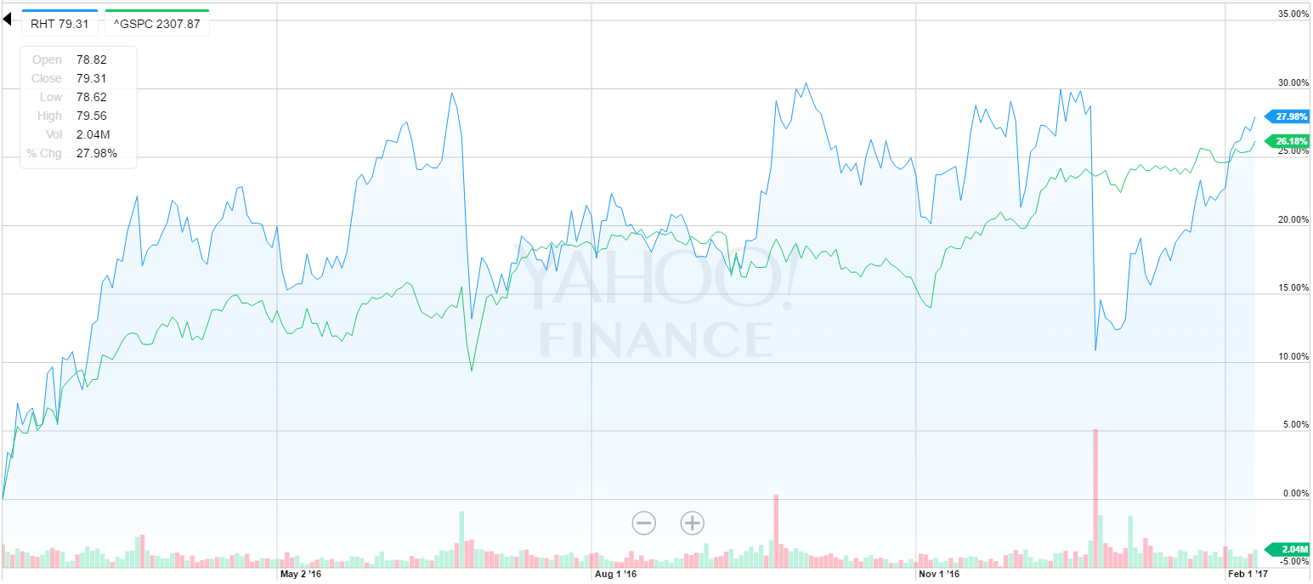
Red Hat Inc (RHT)
Arman Hastings
February , 2017
Technology-Software

Slide 2


Business Overview
RHT is a American provider of open source solutions. They provide reliable and high-performing cloud, virtualization, storage, Linux, and middleware technologies. Red Hat also offers award-winning support, training, and consulting services.
Leading provider of open source solutions.
Tech support for their operating system
RHEL (Red Hat Enterprise Linux ) operating system is a compatibly standard
Founded in 1993 and IPO was in 1999 for $14 a share.
Notes:
- Open source solutions and why it is important
- Tech support - Companies want to be able to have someone to go to, to fall back on in emergency/failure situations.
- Never/not need on individual systems, (as the user should be able to navigate and resolve issues) but is necessary in large scale complex business operations.
- RHEL is now a standard for Physical/hardware servers and Software that interacts on or with linux (RHEL being the OS so they don’t need to but really should
We actually use Red Hat products at osu. Acquired the CentOS Project in 2014

Slide 3

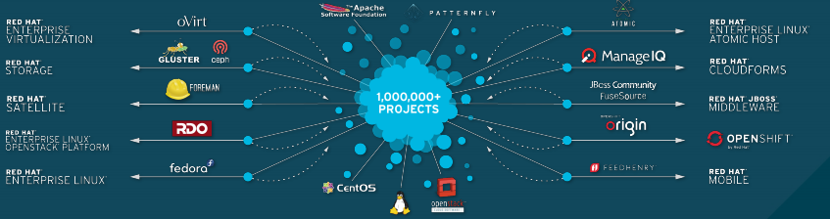
Business Overview
What is Open Source code?
- Open source code is software in which the original source code is made freely and available and may be redistributed and modified.
What is Linux?
- An open-source operating system modeled on UNIX.
Notes:
Technologies
Support and Services
Support – OS support is an additional cost but is also one of the main and most attractive parts of deciding to implement RHT in your company.
Training - Very important for students, industry professionals, and other employees or end users for their wide range of products.
Certification – offered both for professionals and products
Testing consists of at least one 2-4 hour hands on test / code
Consulting - For implementation and more.

Slide 4
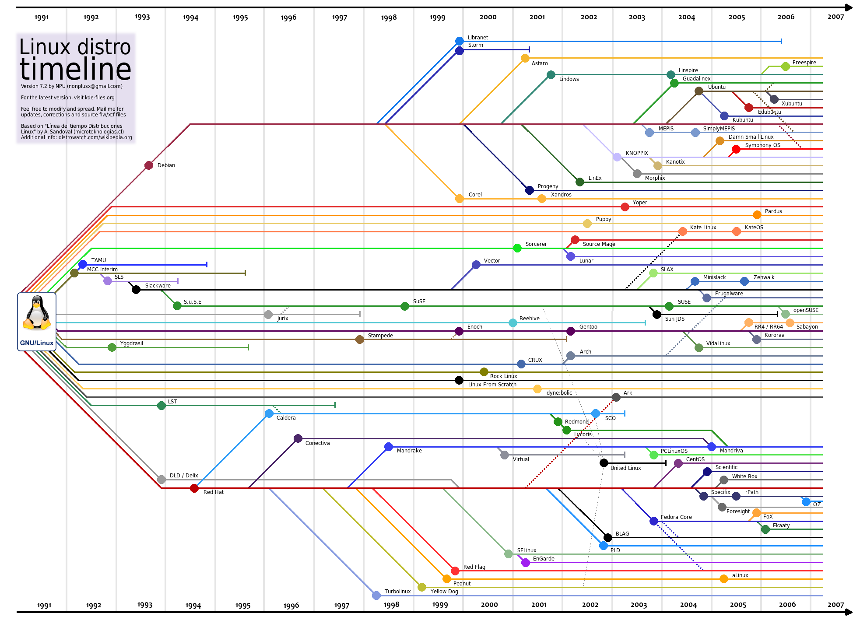
Business Overview
Linux Distributions
Notes:
Linux
Free
Steepler learning curve
Increadibly reliable and secure. With a strong focus on process management, system security and up time
Hardware compat and software compat
Linux is used by corporate, scientific, and academic organizations of every size

Slide 5
Business Overview
Red Hat has two distinct operating segments
Technologies
Linux Platforms
JBoss middleware
Virtualization
Cloud computing
Storage
Mobile
Management
Support and Services
Support
Training
Certification
Consulting
Notes:
Technologies
Support and Services
Support – OS support is an additional cost but is also one of the main and most attractive parts of deciding to implement RHT in your company.
Training - Very important for students, industry professionals, and other employees or end users for their wide range of products.
Certification – offered both for professionals and products
Testing consists of at least one 2-4 hour hands on test / code
Consulting - For implementation and more.

Slide 6
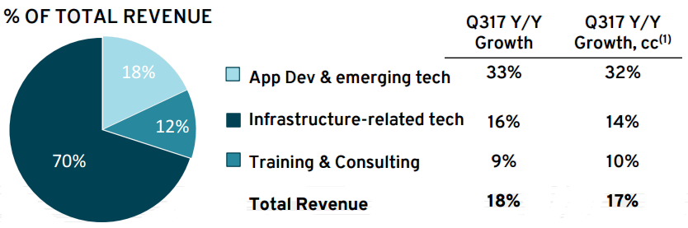
Business Overview
Q3 Highlights:
59th consecutive quarter of revenue growth
Continued strong growth in Application development related products as well as other emerging technologies revenue.

Slide 7
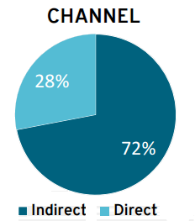
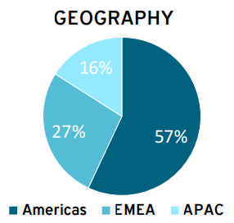
Business Overview
Q3 Highlights:
Top 30 deals were all over $2M, with 26% over $5M and 1% over $10M
Strong cross selling with 60% of top deals including an app-dev/emerging technology offering

Slide 8
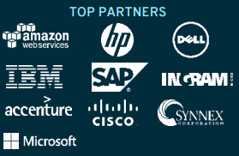
Business Overview
Avenues for growth
Growth through acquisitions
Growth through contracts and contract renewals
Cross selling Developing operations, and emerging technologies.
Strategies for growth
Modernize existing workloads
Enable and manage hybrid cloud
Deliver next generation architectures
Growth through their customers
Notes:
Once contracts are locked in the customers are commited and cant back out.
As their customers grow they will use more and want more products
At the very lease lock in their commitments for a very long time

Slide 9
Corporate Governance
Nine directors on their board with three board committees Audit, Compensation, and nominating & governance.
Key Excecutives:
James Whitehurst
- Chief Exec. Officer, Pres and Director
Paul Cormier
- Interim Chief Technology Officer, Exec. VP and Pres of Products & Technologies
Arun Oberoi
- Exec. VP of Global Sales & Services
Eric Shanfer
- Acting CFO, Frank Calderoni is steps down to accept a CEO job at another company
As of Feb. 2, 2017 (accounting for the change of CFO’s)
ISS Governance QuickScore is: 6
Audit: 2
Board Structure: 2
Compensation: 7
Shareholder Rights: 4
Notes:
Frank Calderoni is steps down to accept a CEO job at another company

Slide 10
Competitive Positioning
Red Hat takes their competitive position from many angles:
Hybrid cloud service
Red Hat takes Linux to the everyday business work and offers support for it.
Their customer support allows companies to be less nervous when integrating power and open source operating systems.
Educates and Certifies to insure correct use and product consistency and full use.
Acquisitions of small projects and companies to grow and gain access to their products. (CentOS)
Staying true to the community that they came from creates a strong customer base and a trusting relation ship.
Notes:
Again the support they offer is one of the most important parts of their business
Linux is a very powerful
People are nervous of its implementation in complex or business settings
Open source is always better but needs the right security that Red Hat offers.
Education is free on their youtube or webpage
Certifications again for individuals or other software/hardware products
New standard. Allows them to become a staple (which they arguably already are)
How they came from open source and even thought its not free any more($$) The code and concepts are still free
1 Contributor to OpenStack
2 Contributor to Docker
2 Contributor to Kubernetes
1 Contributor to NFV Neutron-OpenDaylight-vSwitch
1 Contributor to Ansible
1 Contributor to Gluster & Ceph
Their hybrid cloud is used wth their software like Jboss
on site, virtual, private, public, or hybrid cloud.

Slide 11
SWAT Analysis
Strengths
Consistent revenue growth with contracts and renewals
Strong customer base
Hybrid cloud software services
Weaknesses
Dependent on negotiations and contract closing
Small market share
Opportunities
Increasing demand for open source software
Strategic acquisitions
Increase in demand the Cloud Computing market
Threats
Intense competition from many other competitors
Economic slowdown and fluctuations
Product defects and bugs
Notes:
STR
WEAK
OPP
THREAS
- flucuation of foreign currecny is always there

Slide 12
Current Events
Red Hat and Boston University Collaborate to Advance Emerging Technologies and Open Source Research and Education - 2/1/17
European Bioinformatics Institute and Red Hat Collaborate to Enhance Global Biological Research Capabilities 1/31/2017
Red Hat CFO Frank Calderoni is steps down to accept a CEO job at another company, and will be replaced on an interim basis by principal accounting officer Eric Shander. – 12/21/17
Notes:
Red Hat plans five-year, $5 million commitment to Boston University’s Cloud Computing Initiative to advance research on cloud computing, machine learning and automation, and big data
European Molecular Biology Laboratory, is using Red Hat OpenStack Platform to deliver the scale and flexibility required to drive its Embassy Cloud project. The goal of Embassy Cloud is to transform the way collaborative research,

Slide 13
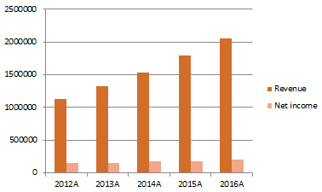
Financial Performance
After their growth and success with contracts in Q3, Red Hat anticipates 2017 to finish strong and to keep that momentum they have moving forward.

Slide 14
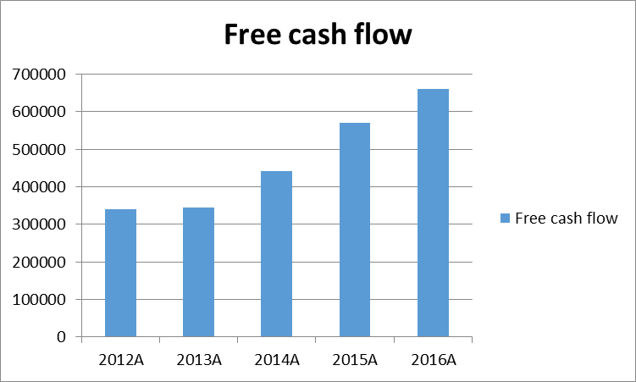
Financial Performance
Red Hat as also been keeping and building on their free cash flow year over year allowing them to allocate it into more into emerging products or towards future acquisitions.
Notes:
Since 1999 they have acquired 30 companies/projects

Slide 15
Valuation: DCF
Q3 earning call forecasted 17% percent growth in revenue for 2017A
Revenue growth to remain steadily increasing throughout 2017 and beyond
More end of the year renewal or commitments to be seen in Q4 as they were seen in Q3
Government contracts that did not close (due to political environment) in Q3 to be re-negotiated and closed in Q4.
Strengthened dollar in Q3 helped Q3 and will hopefully help Q4 to end strongly as well for international contract.
Valuation: $45.21 that is weighted at 30%
Notes:
Forecasted 23% operating margin for 2017A
Forecasted cash flow to be 22%-28% up from last year
- Customers try to negotiate their contracts at the ending of quarters and of the year thinking they will get a better deal.
Naturally with Q4 renewals and new cotracts to be impletemented in the next fiscal year to be discussed and closed.
- Does not land within analyst estimates.

Slide 16
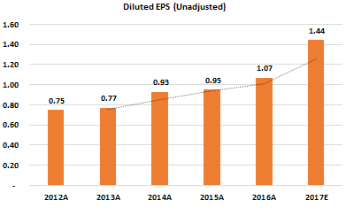
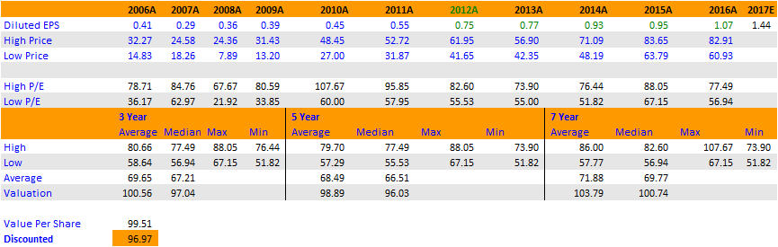
Valuation: Historical
Q3 Earnings call expects a 2017A forecast of 1.48 for EPS
Valuation of $96.97 that is weighted at 45%
Notes:
Has had a steady climb of EPS since 2008A
In their most recent Q3 earnings call forecasted an EPS between 1.45 - 1.49

Slide 17
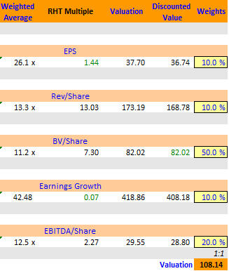
Valuation: Comparable
Negative P/E and EV/EBITDA values were given 0% weights for; NOW, WDAY, and DATA
Valuation of $108.14 that is weighted at 25%
Notes:
- Ignore comparable EV Sales. For that I was substituting the negative p/e and EV/EBITA values.
- Purely built by curiosity if values were substitute based off of recommendations. Something to consider in the future.
Negative P/e and EV/EBITDA were given 0% weights.
Non of the comparable companies directly compete or “Do” what RHT does. But many of them have overlapping and expanding business segments bleeding over into each other.

Slide 18
Recommendation
With an intrinsic valuation of $84.20 and a margin of safety of 8.3% I recommend a BUY.
BUY
Red Hat is a very unique growth stock and fits well into our current holdings in the Large Cap portfolio.
Notes:
I believe Red hat is unqiue company and offers some nice revenue stability for a growth stock by their contracts and expansion. I also feel that red hat would fit perfectly into out large cap porfotlio as nothing we hold right now is similar to it except for google

